Slide 1










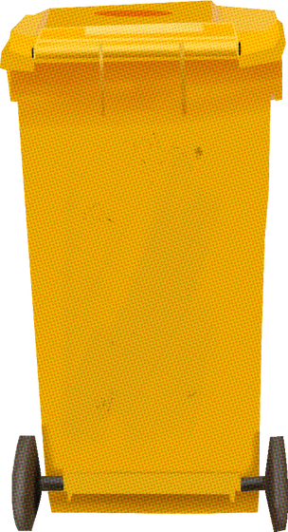
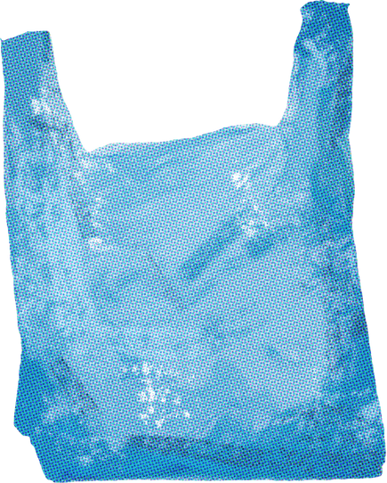


SwachhSanket
TOWARDS A SUSTAINABLE WORLD
Team : Hire us pls

Slide 2

PROBLEM STATEMENT
Project aimed at tackling waste reduction and recycling challenges through technology and innovation.
Problems
Tracking Waste Generation
Solutions
Daily Waste Tracker
Education and Engagement
Waste Categorization & Suggestion
Locating processing centers
Maps integration
Awareness
Events and Initiatives

Slide 3
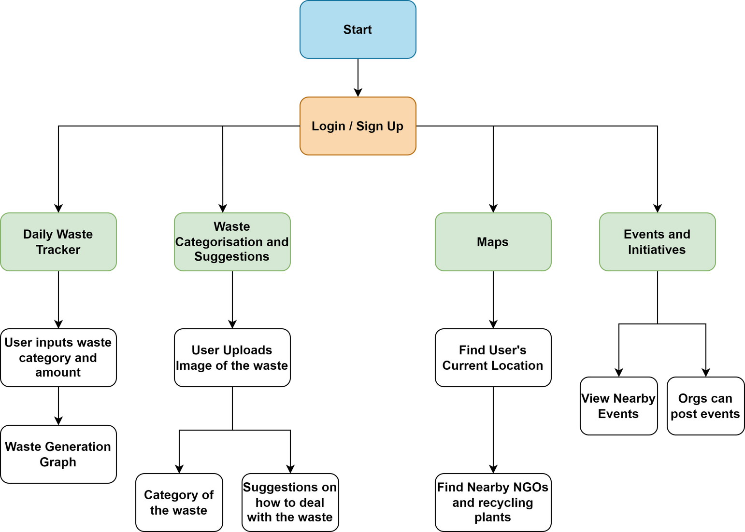
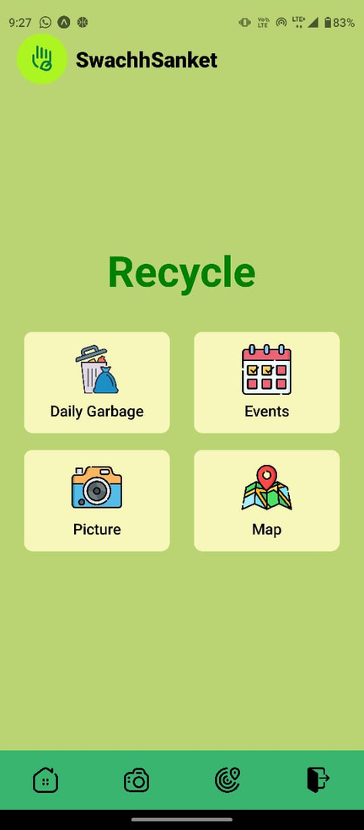
SOLUTION DESIGN

Slide 4
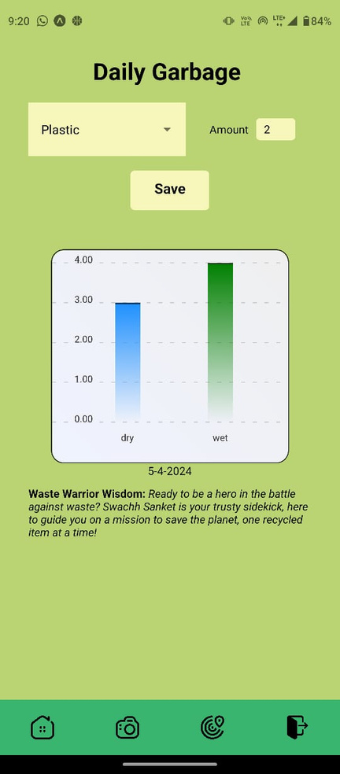
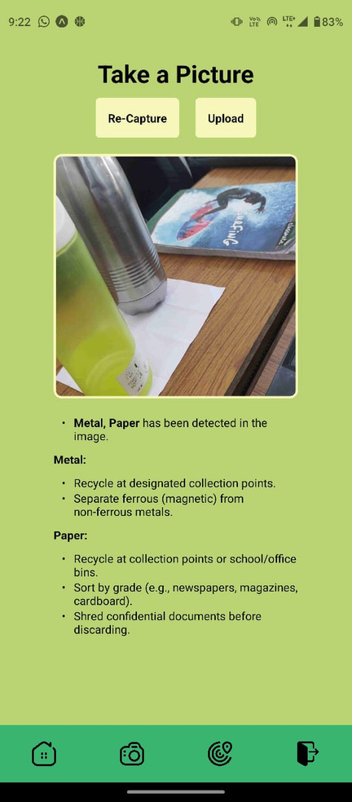
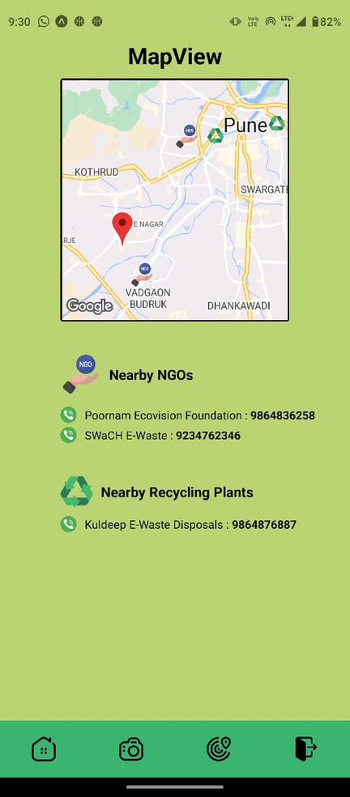
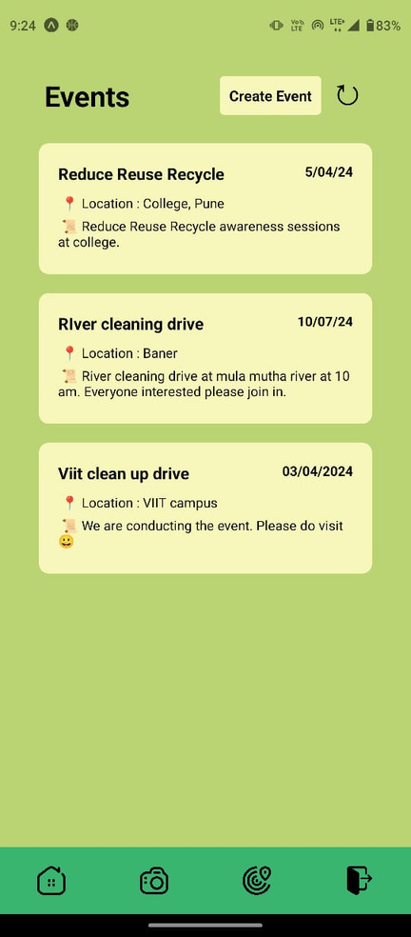
PROTOTYPE

Slide 5





POTENTIAL GROWTH
Marketplace
Personalized analytics & suggestions
Gamifying
Smart Bins for corporate/ communities
Automated Sorting from a picture

Slide 6
CHALLENGES
OVERCOME
Hosting problems the model on Google Colab
Hosted the model locally
Sending Image to Garbage Detection Model
Converted Image to Base64 string

Slide 7



KEY LEARNING OUTCOMES
REACT NATIVE
GEMINI API
NGROK

Slide 8
REFERENCES
React Native Docs : https://reactnative.dev/docs/getting-started
Firebase Docs : https://firebase.google.com/docs
Pretrained model : https://huggingface.co/keremberke/yolov5m-garbage
Gemini Quickstart : https://ai.google.dev/tutorials/python_quickstart

Slide 9
THANK YOU

